Slide 1



Auto ML
Auto ML
Prepared by Shyamala Venkatakrishnan, Heejae Roh
Nikshita Ranganathan, Archit Barua
Professor Venkata Duvvuri
Dec 16th, 2022
Auto ML
Auto ML
Notes:
Source(northeastern mark): https://brand.northeastern.edu/visual-identity/university-wordmarks/
Source(Oracle logo): https://www.pngegg.com/en/png-btbgn/download
Source: https://1330878074.rsc.cdn77.org/wp-content/uploads/2020/02/Oracle-Announces-Oracle-Cloud-Data-Science-Platform.jpg
Color: https://usbrandcolors.com/oracle-colors/

Slide 2

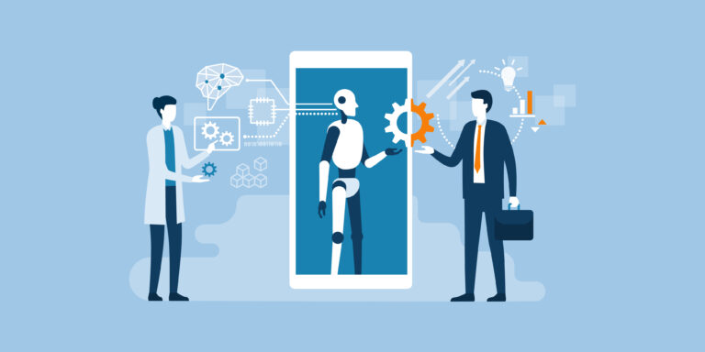
What is Auto ML?
Auto ML: the process of applying machine learning (ML) models to real-world problems
Auto ML automates the selection, composition and parameterization of machine learning models.
Notes:
Source(northeastern mark): https://brand.northeastern.edu/visual-identity/university-wordmarks/
Source: https://www.springboard.com/blog/data-science/machine-learning-how-to-survive-first-week/

Slide 3

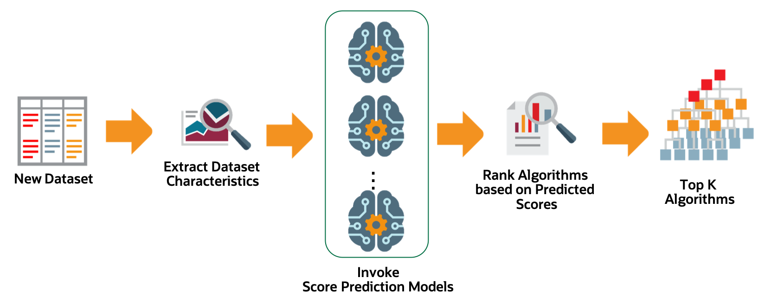
Auto ML
Notes:
Script: If we put new dataset on Oracle Cloud, Oracle Auto ML extract relevant dataset characteristics. And specialize score-prediction metamodels across a wide variety of datasets. And Rank algorithms based on their predicted performance. We will let you know how to import dataset and execute Auto ML. We will let you know how to import dataset and execute Auto ML
Source(background): https://www.opendesktop.org/p/1446980
Source(photo): https://docs.oracle.com/en-us/iaas/tools/ads-sdk/latest/user_guide/automl/overview.html

Slide 4
Auto ML
Prerequisites
Data Load
01
02
Autonomous Database
Lunchpad
Importing Data
Run Auto ML
Q&A
03
04
Hotel booking dataset
Notebooks
Notes:
Source(background): https://www.opendesktop.org/p/1446980

Slide 5

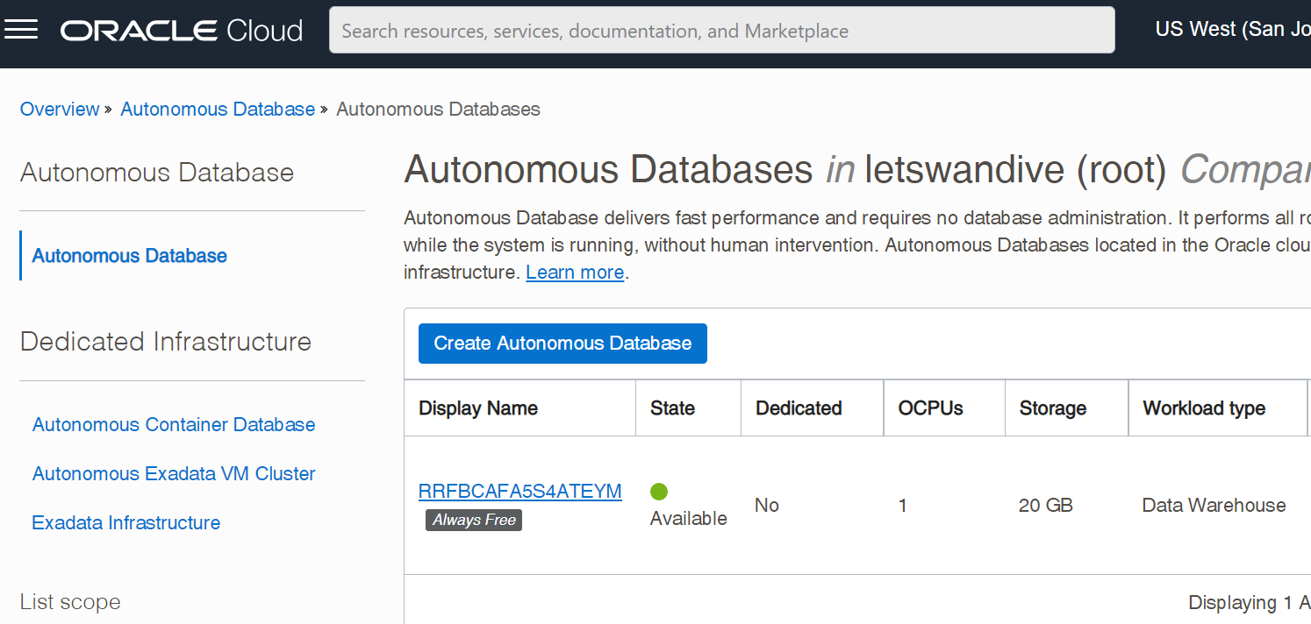
Creating
Autonomous Database
Part1
Prerequisites
Follow these process
Click here to make Database
After setting up account for Oracle cloud
Make your Autonomous Database
with ‘Create Autonomous Database’
Notes:
Source: https://cloud.oracle.com/

Slide 6
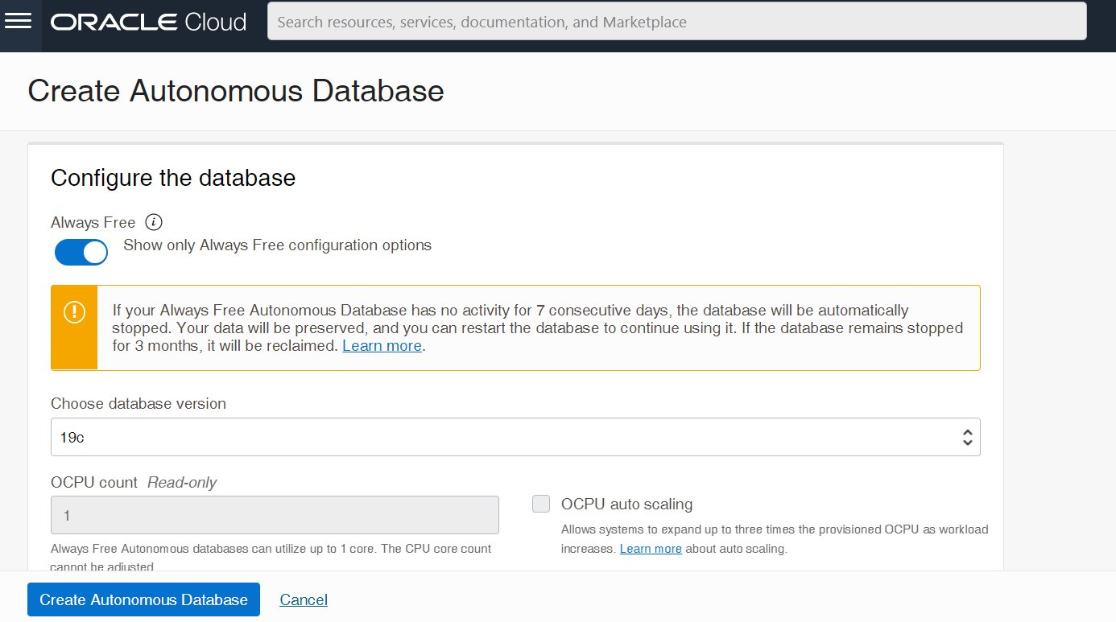
Creating
Autonomous Database
Part1
Prerequisites
Check here to make Always Free Database
Choose Always Free Database option
Prevent the unexpected charges from your database.
You can update your account with your extra permission
Notes:
Source: https://cloud.oracle.com/

Slide 7
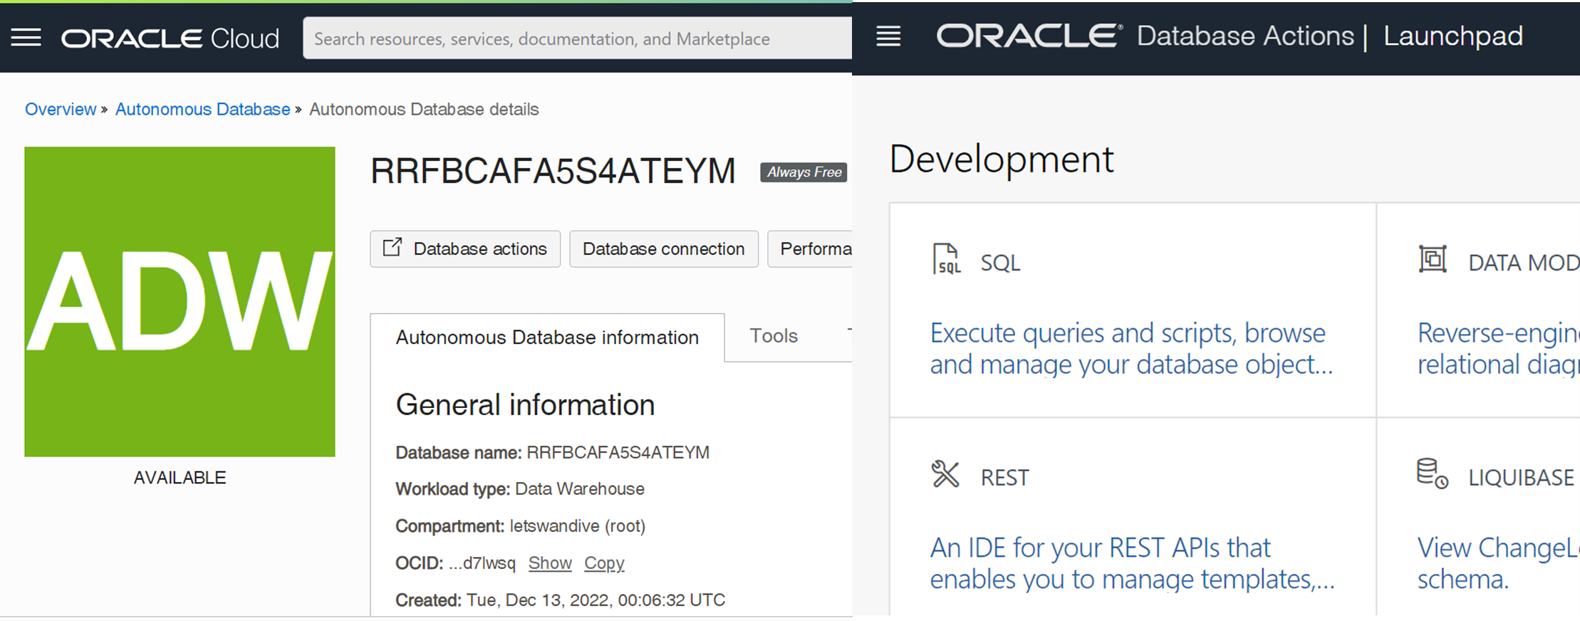
Part1
Prerequisites
Access to Launchpad
Click here to access to Launchpad
Launchpad has almost everything you want
Notes:
Script: Click database actions to access to Launchpad
Source: https://cloud.oracle.com/

Slide 8
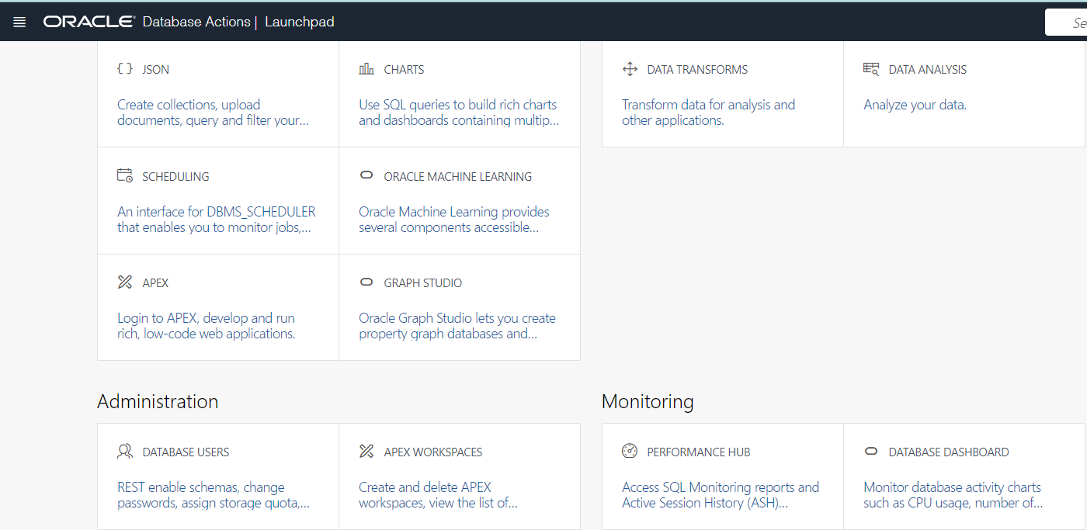
Part1
Prerequisites
What’s in Launchpad
Click here to access to make User
Notes:
Source: https://cloud.oracle.com/

Slide 9
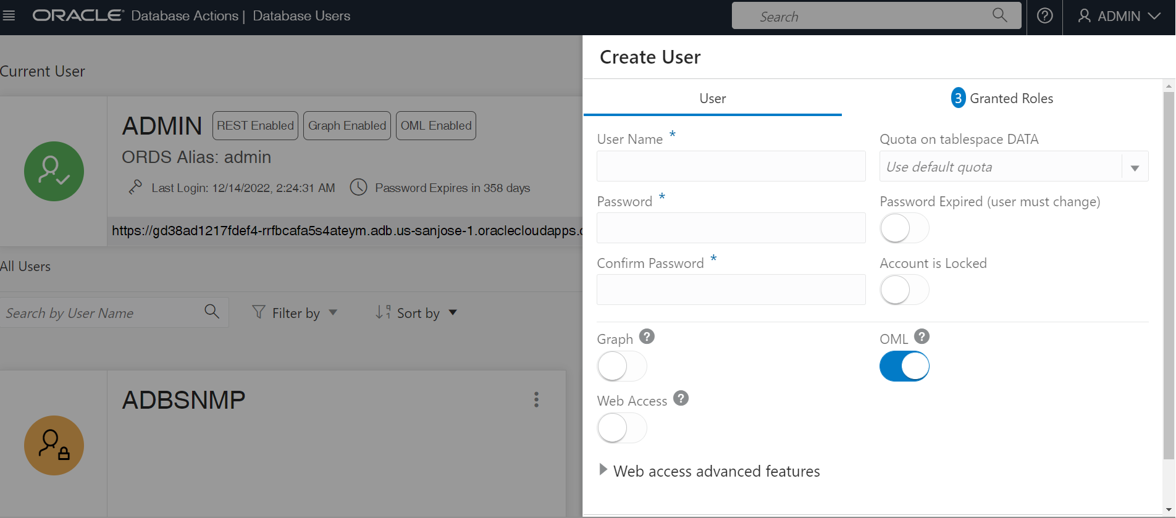
Part1
Make DATABASE User
with Oracle Machine Learning Enable
Prerequisites
Enable Machine Learning
OML: Oracle Machine Learning
Notes:
Source: https://cloud.oracle.com/

Slide 10
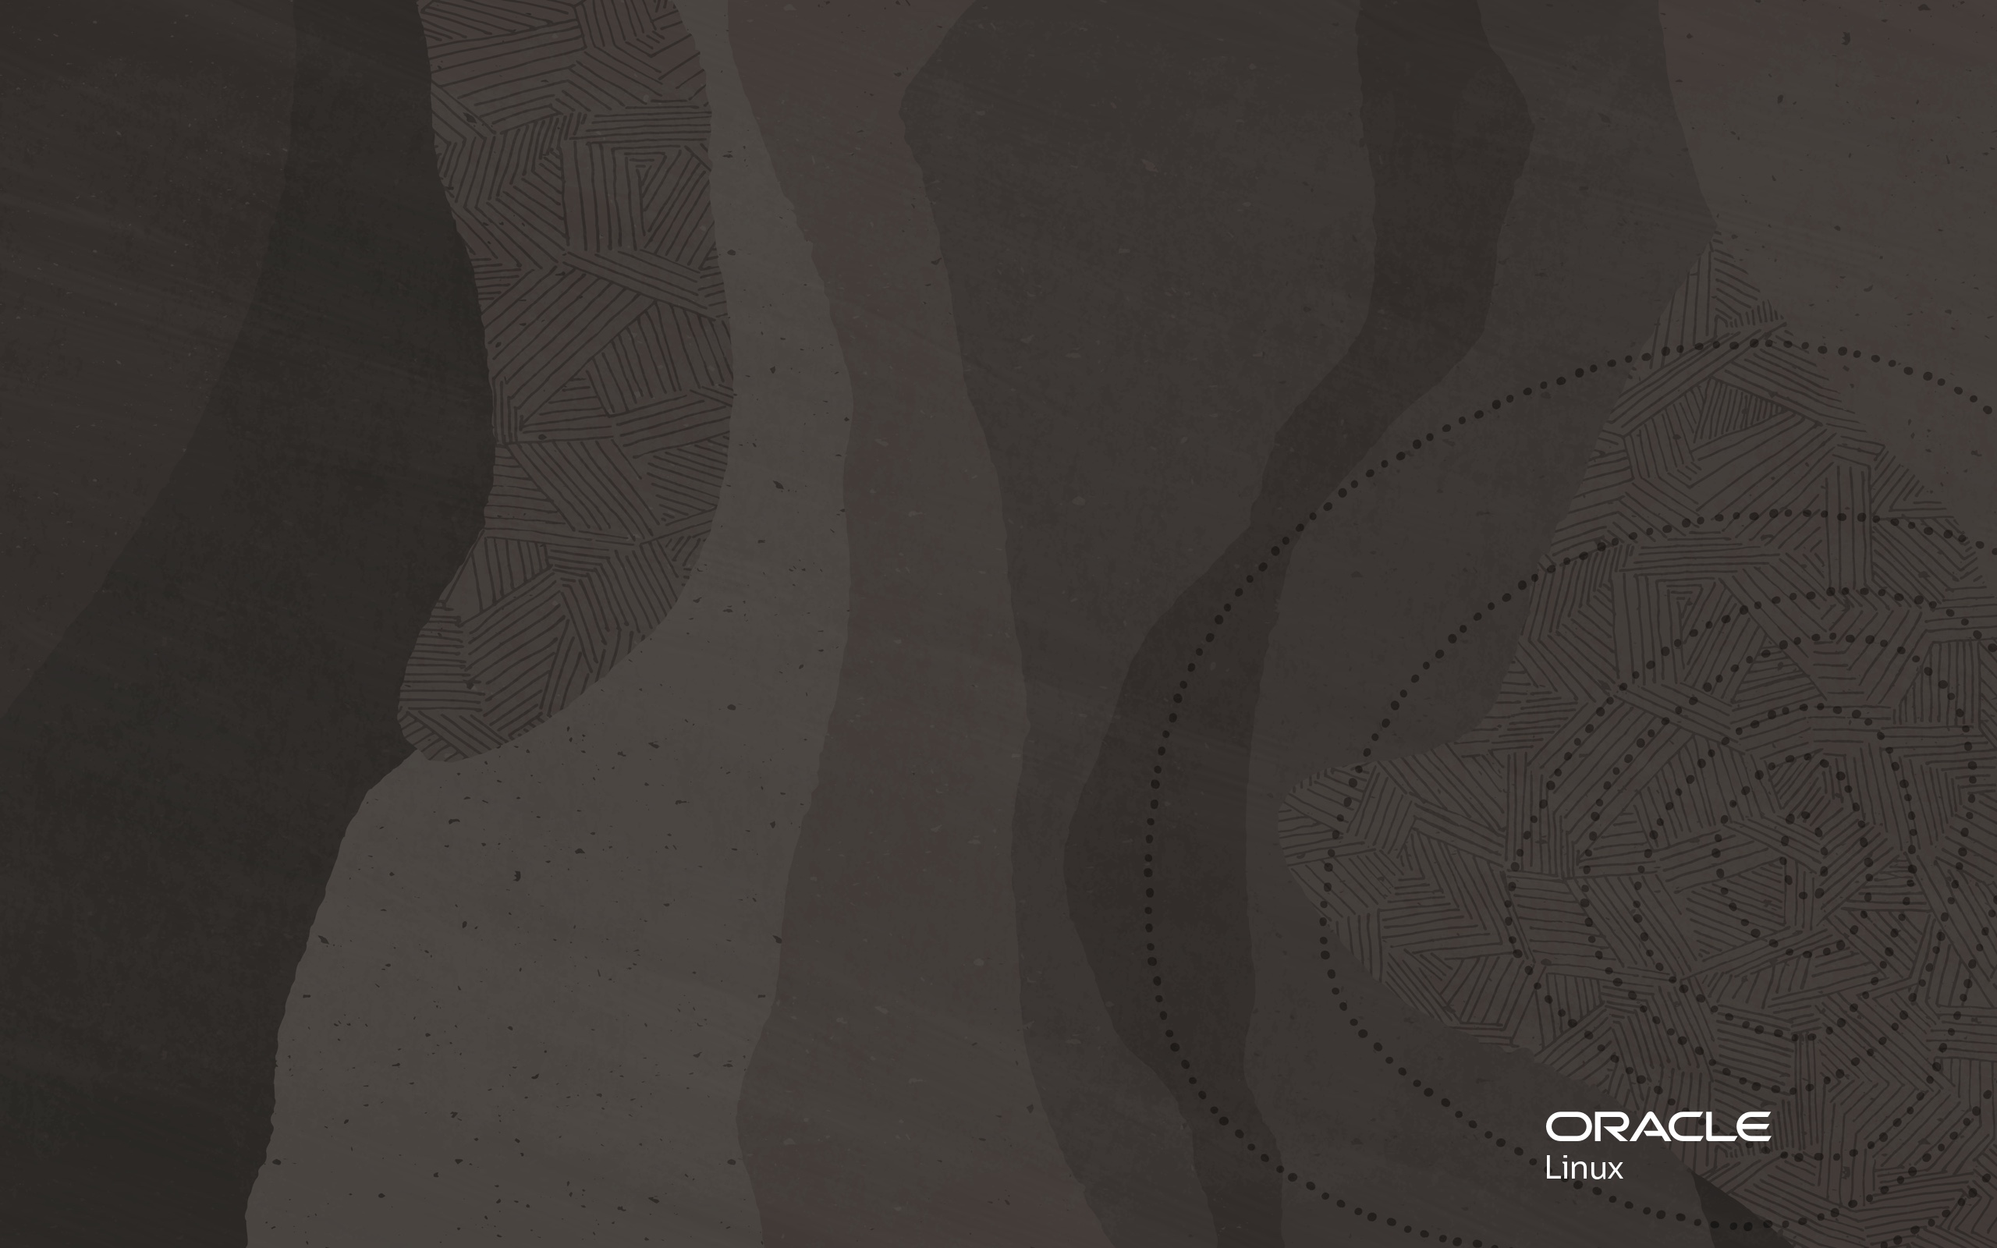
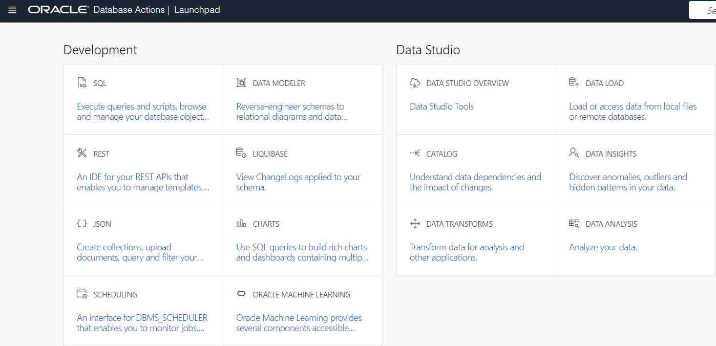
Part2
Data Import
What’s in Launchpad
Click here to access to Import Data
Launchpad has almost everything you want
Notes:
Source: https://cloud.oracle.com/

Slide 11
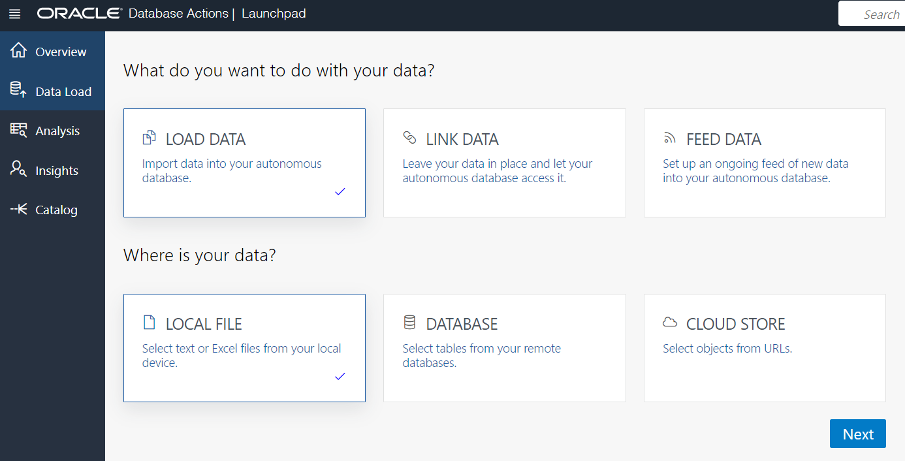
Part2
Data Import
Load File in LOAD DATA
Click Next to upload your file
Notes:
Source: https://cloud.oracle.com/

Slide 12
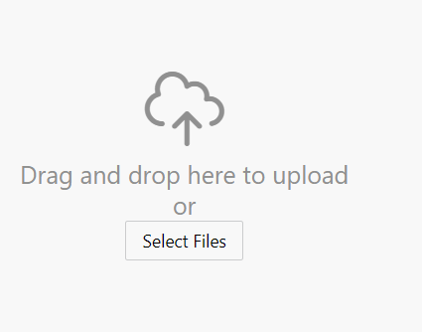
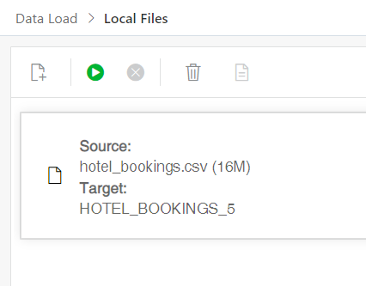



Part2
Data Import
Load File in LOAD DATA
Notes:
Source: https://cloud.oracle.com/

Slide 13
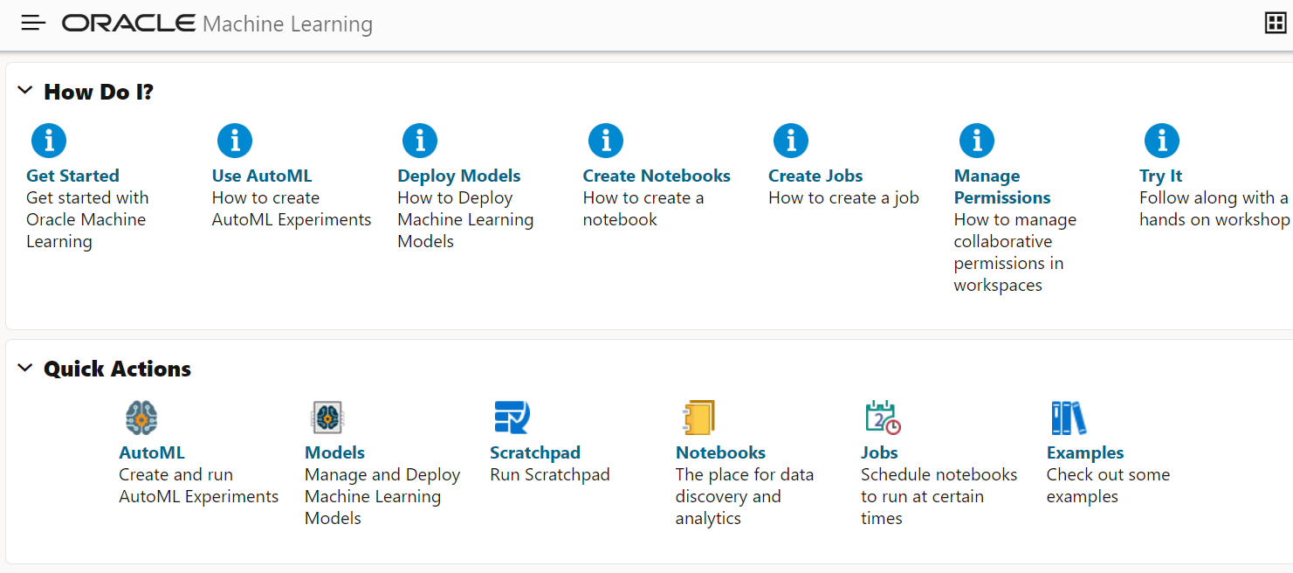
Part3
Run AutoML
Choose Auto ML
in Oracle machine Learning Dashboard
Click here to make AutoML
Notes:
Source: https://cloud.oracle.com/

Slide 14
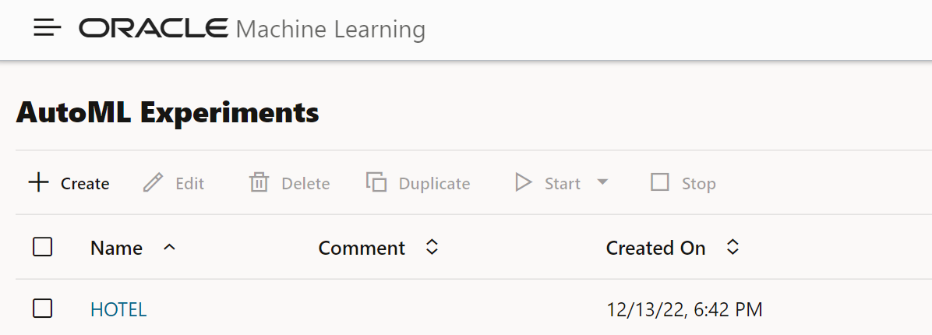
Part3
Run AutoML
Create Auto ML
Click here to create AutoML
Notes:
Source: https://cloud.oracle.com/

Slide 15
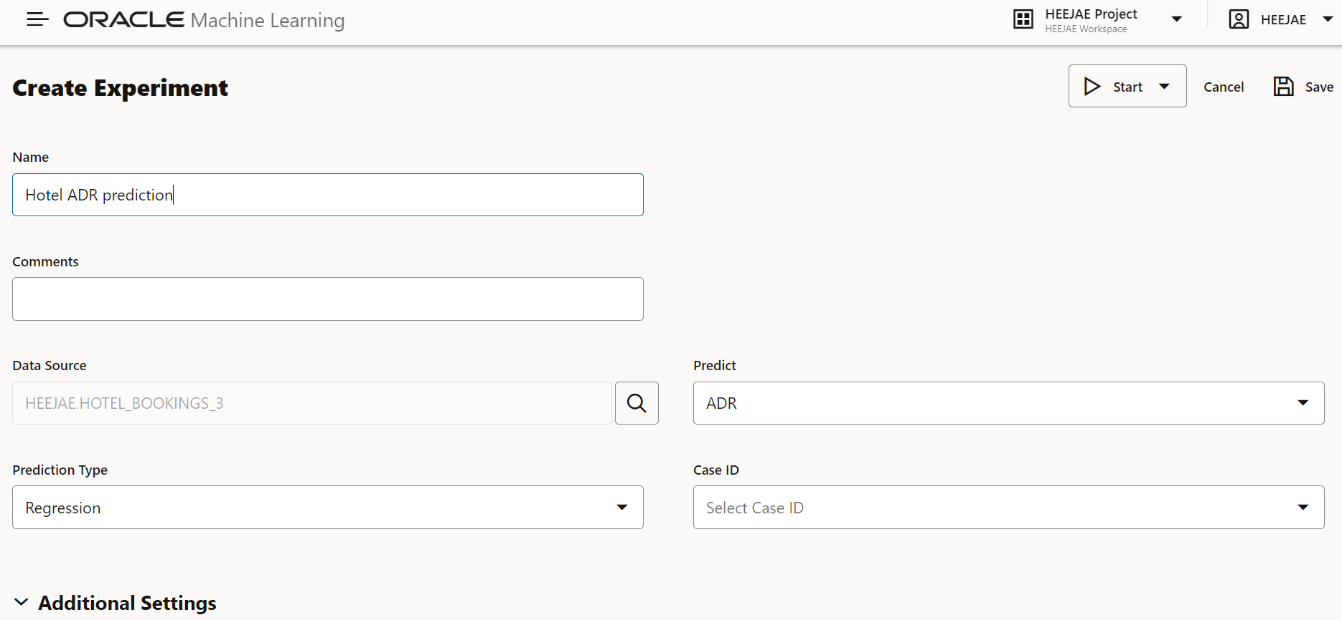








Part3
Run AutoML
Create Experiment
Name it
Choose data sourse we imported
Select Target variable
Prediction type as Regression
Notes:
Source: https://cloud.oracle.com/

Slide 16
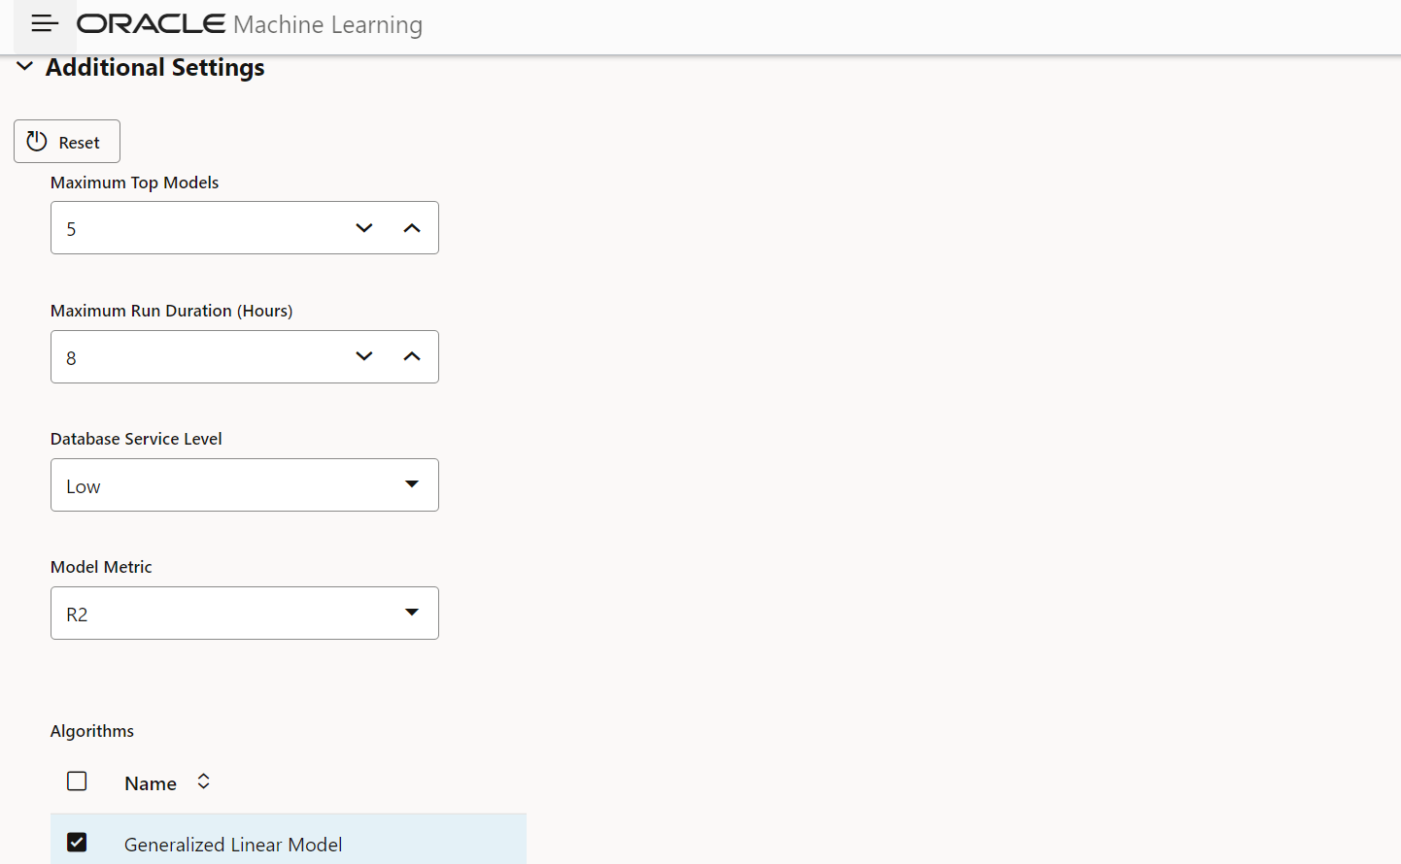
Part3
Run AutoML
Change Model metric to R2
Choose R2 as model matrix
Notes:
Source: https://cloud.oracle.com/

Slide 17
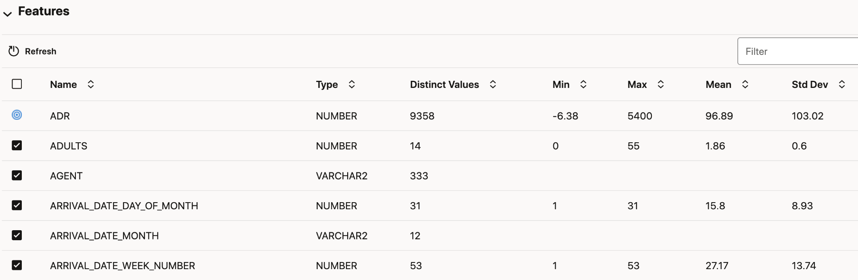
Part3
Run AutoML
Selecting the features for the model
The above panel shows the features available for selection as predictor variables for the models.
The summary information for each feature is displayed.
The checkboxes present against each feature can be used to add or remove the predictor variables.
Notes:
Source: https://cloud.oracle.com/

Slide 18
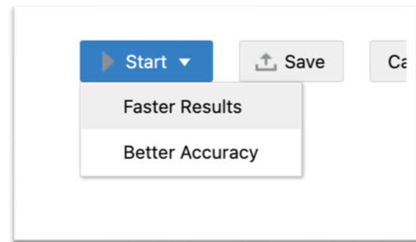
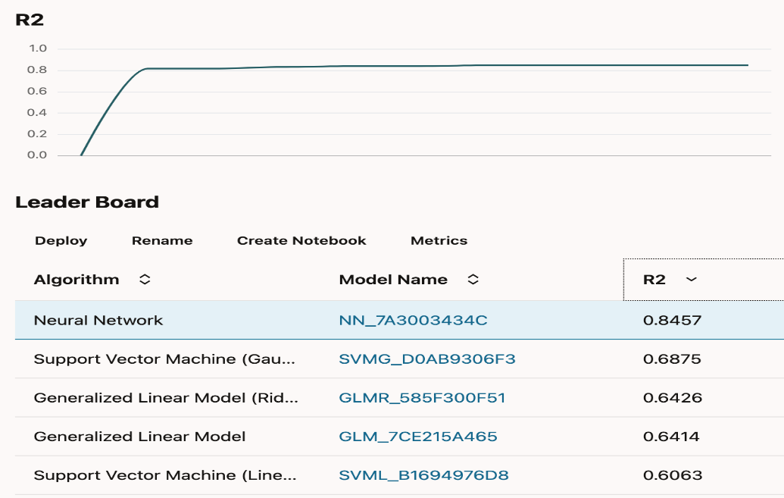
Part3
Starting the models
Run AutoML
After defining the model, in the top-right hand corner of the experiment, we can choose to start the models either with “Faster results” or “better accuracy’.
Selecting “Faster Results” option builds the models in lesser time when compared with “Better Accuracy” option.
As the model runs, a checklist appears in the upper right hand section with updates on its progress.
A leaderboard is displayed which ranks the models based on the model metric selected for the experiment.
Notes:
Source: https://cloud.oracle.com/

Slide 19
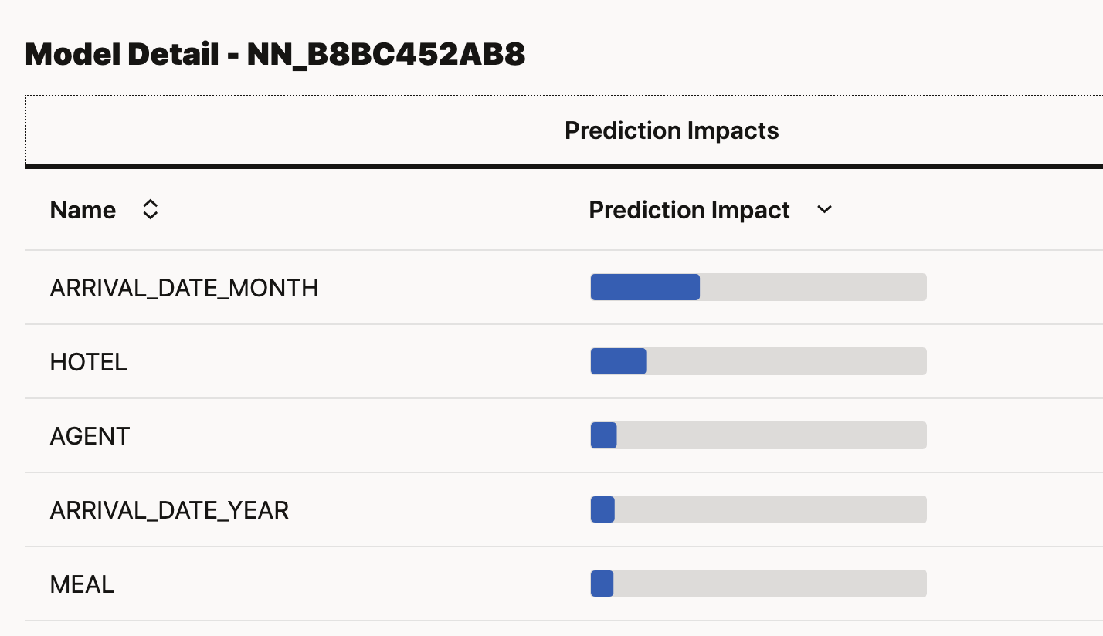
Part3
Knowing the prediction impact
Of the features after the model
Run AutoML
The prediction impact of the most important features can be found
by selecting a model.
In the above image, model running with Neural Network algorithm and
name NN_B8BC452AB8 is selected.
Notes:
Source: https://cloud.oracle.com/

Slide 20
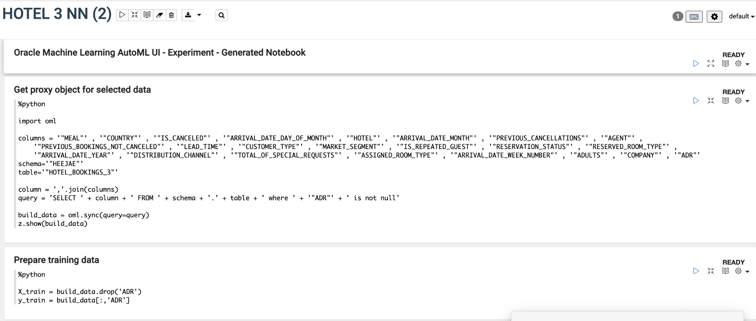
Part3
Run AutoML
Working with Auto Model Notebooks
Oracle notebooks can be created for a model by clicking on “Create Notebook” option in the Leaderboard section.
They are similar to Jupyter notebooks and provides interface to run SQL queries, create visualizations, and experiment with machine learning,
The cells can be run to clean the data, create and fit the model and rate its accuracy.
Notes:
Source: https://cloud.oracle.com/

Slide 21
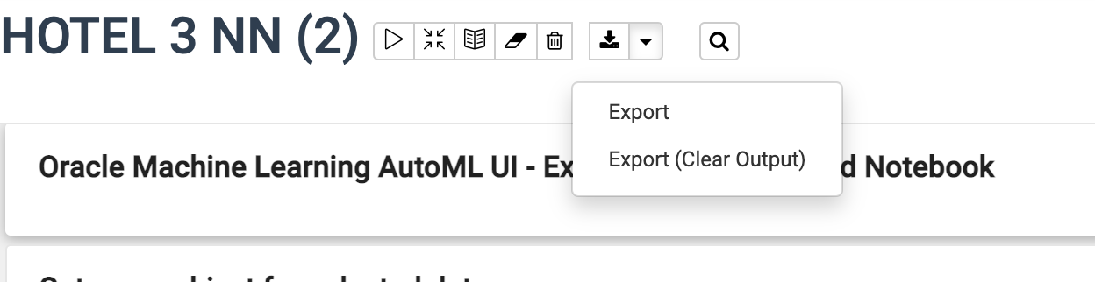
Part3
Run AutoML
Working with Auto Model Notebooks
The notebooks can be run directly in this page or it can be downloaded and exported by using “Export” option.
Notes:
Source: https://cloud.oracle.com/

Slide 22

Q&A
Q&A
Notes:
Source: https://1330878074.rsc.cdn77.org/wp-content/uploads/2020/02/Oracle-Announces-Oracle-Cloud-Data-Science-Platform.jpg

